Slide 1
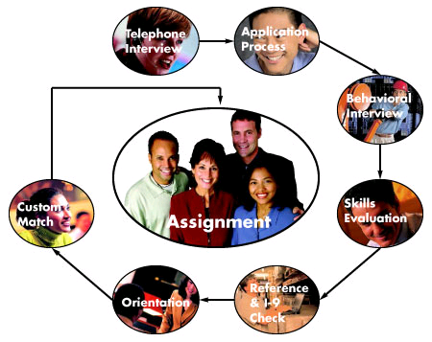
Helpful hints to land that Job!
Rhonda Barbosa, Human Resources, Jefferson Lab

Slide 2
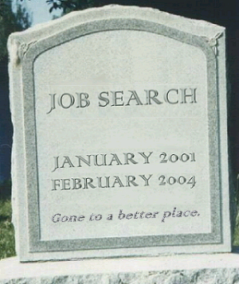
Finding a Job is Your Job
Prepare
Research the prospective employer
Why?
Write a resume or CV
Write a cover letter
Prepare for all types of questions
Open-ended
Situational
Behavioral

Slide 3
Research the Prospective Employer
The more you know about them, the more they will want to know about you
Know their history, mission, values
Start at their website
Develop your resume and any meetings with the employer toward things that will resonate with them
Do a Web search for recent news
Demonstrate your knowledge in your cover letter

Slide 4
Resume or CV
Resume is most effective for
Business, industry, government jobs
Some research jobs in industry prefer a CV
Jobs that include managerial responsibilities
Jobs where performance is measured by results
CV is appropriate for
Academic jobs
Grant, scholarship and fellowship applications

Slide 5
Résumé
General
Provides a general and concise introduction to your experiences and skills as they relate to a particular career or position
Should be altered for each position that you are applying for
No more than one or two pages
Should always include a cover letter
Content
Name and Contact Information: your residential address is best
Education: a listing of your degrees or certifications and educational institutions or programs
Work Experience: names of the companies or institutions you have worked for, the location of each, dates worked, your job title(s), and duties performed
Accomplishments: Products, outcomes, results for which you were partly or routinely responsible
Can be integrated into Work Experience
Should highlight areas that could translate to new job

Slide 6
Curriculum Vitae (CV)
Purpose
Teaching or research jobs, fellowships, grants, or further education
Format
Focused on academic achievements
Longer than resume since the emphasis is on completeness vs brevity
Content
Name and address
Education
Dissertation
Fellowships and awards
Areas of research/teaching Interest or specialization; areas of particular competence/expertise
Teaching experience
Research experience
Publications and presentations
Works in progress
Related professional experience
Languages
References

Slide 7
Cover Letter
Purpose
Introduces your resume or CV to the prospective employer
Encourages the reader to interview you
Serves as the first sample of your writing ability and attention to detail
Content
State why you are writing and for what position you are applying.
Emphasize why you want to work for the prospective employer
Explain why you would be a good fit
Convey enthusiasm for the position.
Highlight resume or CV key information, but don’t just repeat it
Show you have done your homework
Encourage the reader to take a closer look at your resume or CV
Format
Make it brief – no more than one page
Address it to a specific person
Use an adequate font size and margins
Include your name, address, email, and phone number
Proofread for spelling or grammatical errors.
Use active voice and avoid acronyms and extra words

Slide 8
Prepare for Interview Questions
Typical questions
Why do you want to work for us?
Give us an example of a situation where you...
Didn't meet your goals or objectives
Faced conflict or communication problems
Were faced with a challenge you were unsure how to meet
Where do you see yourself in 3/5/10 years?
What would your current advisor/manager say are your…
Strengths?
Weaknesses?
Why should we offer you this job?
Do you prefer working on a team or on your own?

Slide 9
Resources
Science Careers from the Science Journal (http://sciencecareers.sciencemag.org/tools_tips/how_to_series)
MIT Job Search Preparation Guide (http://gecd.mit.edu/jobs/find/prepare)
Personal Branding Blog (packaging and promoting yourself)
Careerealism Blog (methods for job searching in today’s workforce)
Interview Questions Q & A

Slide 10
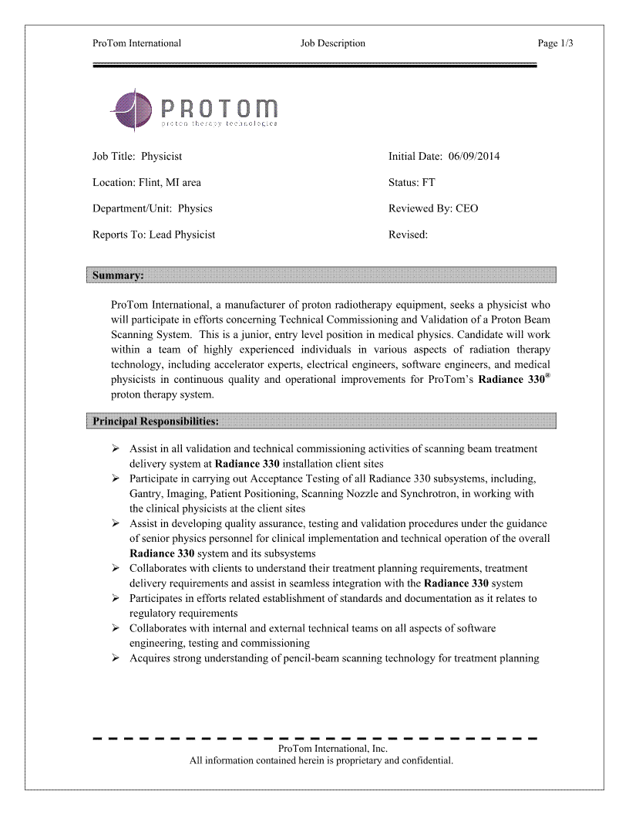
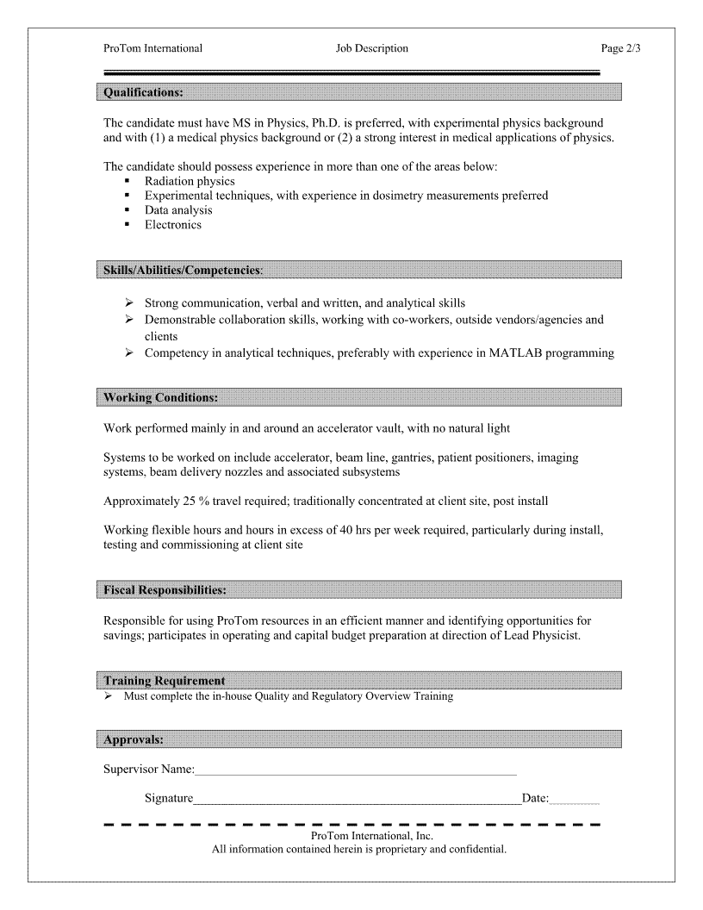
Look at verbs!

Slide 11
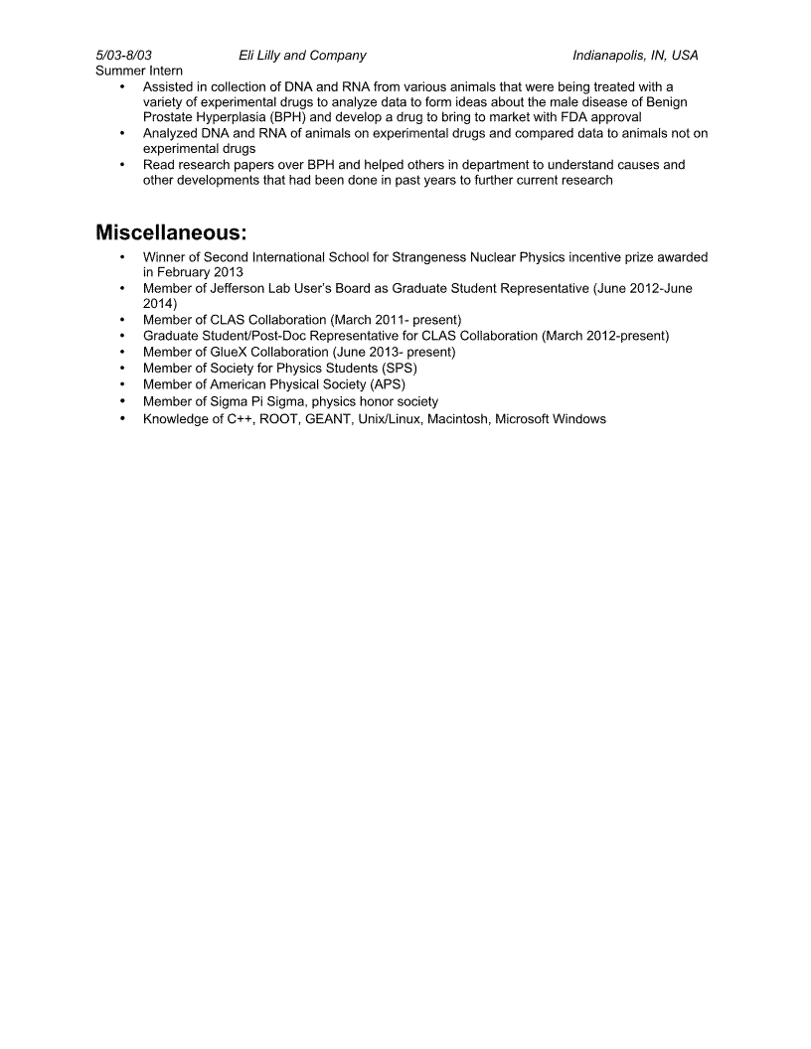
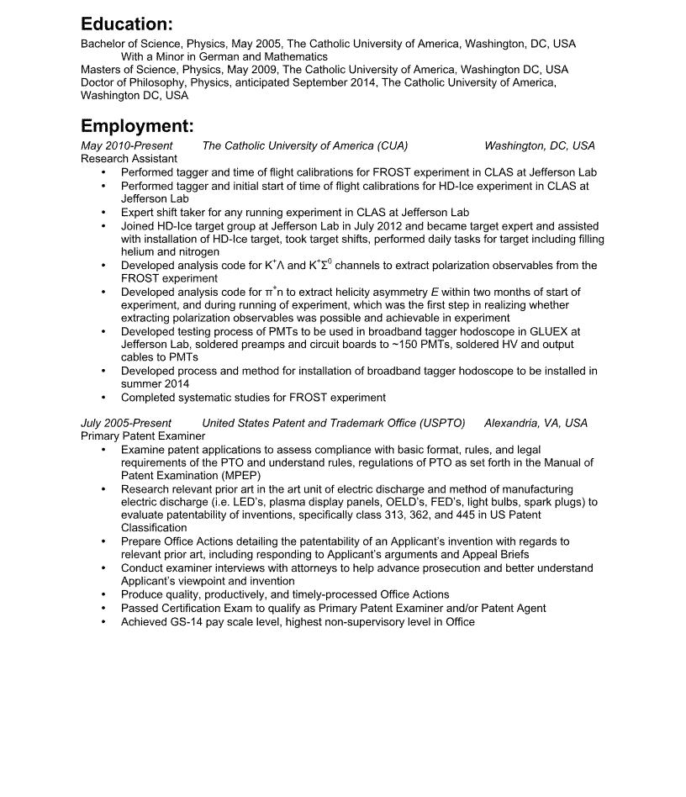
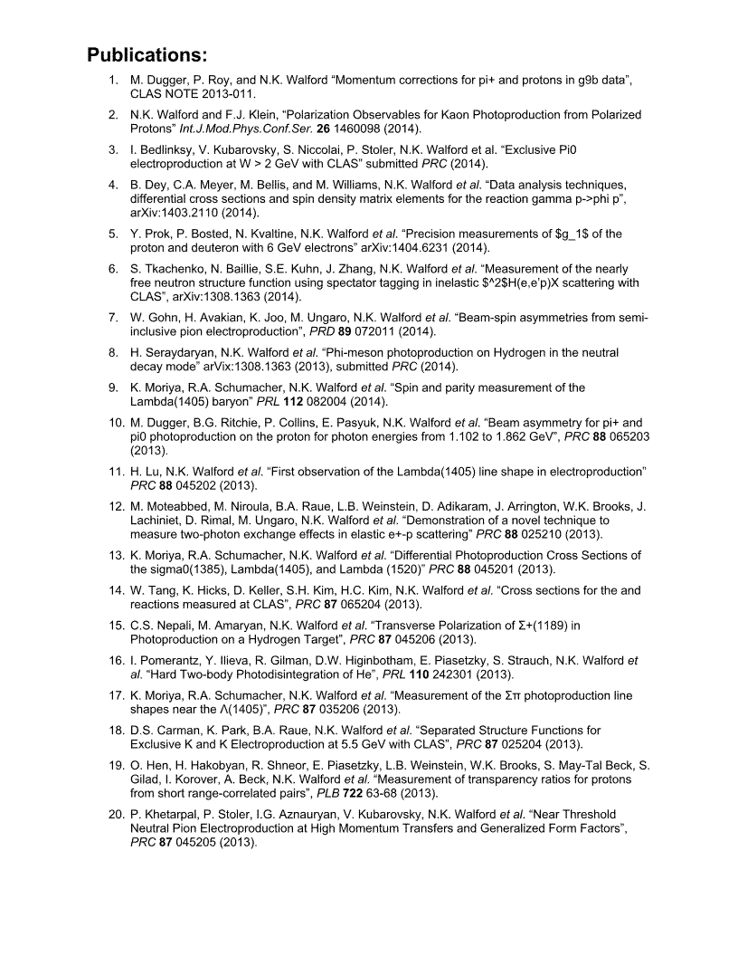
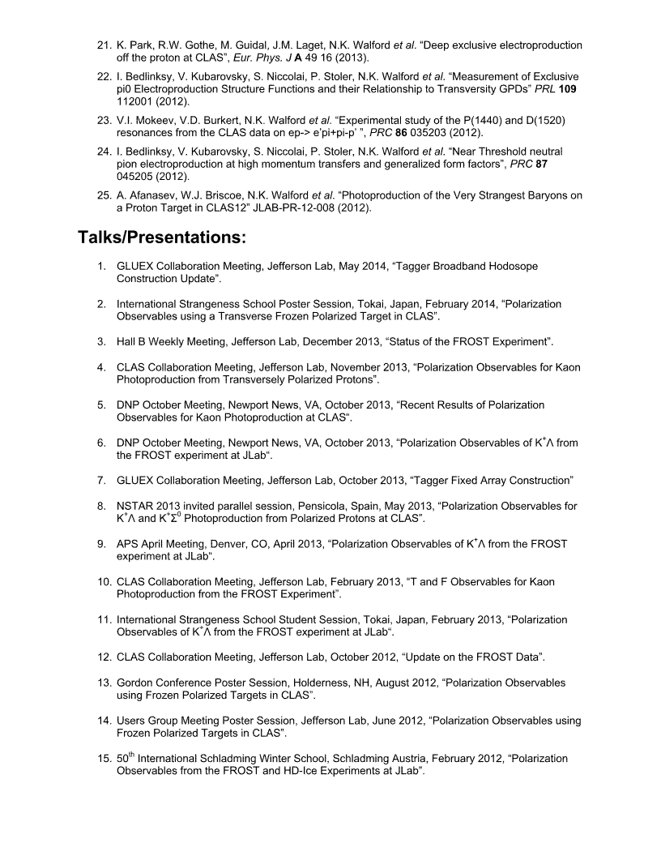
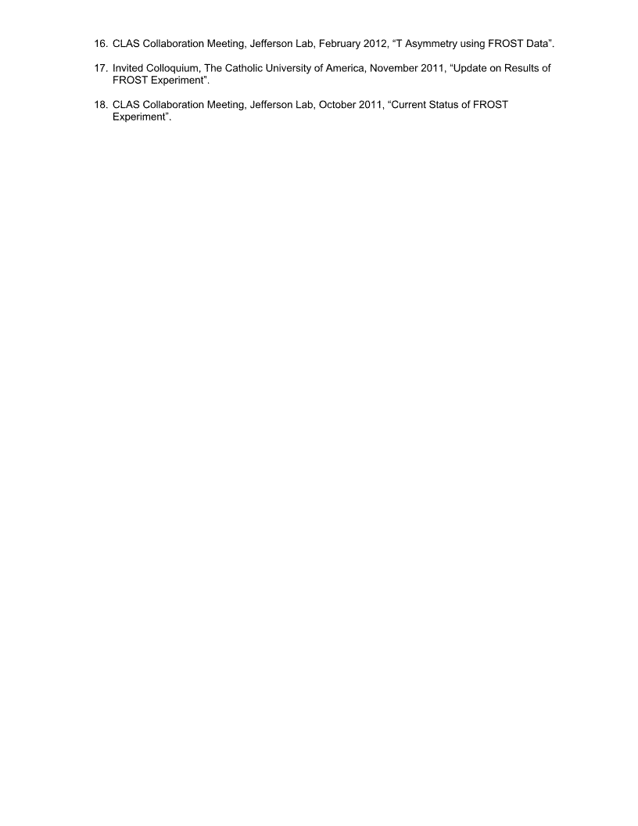
with minors
on
---- --------------- what
/
---- --------------------------
No verb
P
/
/
/
/
/ /

Slide 12
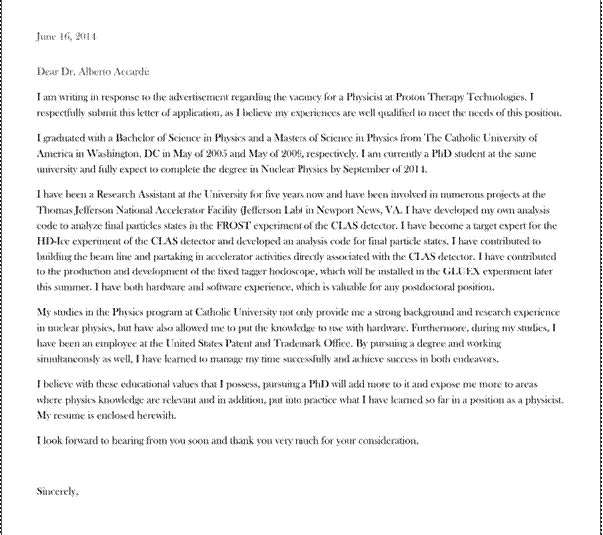
Comment [u2]: You are qualified, not your experiences
Comment [u23: Do you mean “participating?”
Comment [u4]: Do you mean “credentials?”
Comment [u5]: Important paragraph, but you focus on what they can do for you and not what you can do for them.
Where do you indicate an interest in the medical applications of Physics?

Slide 14
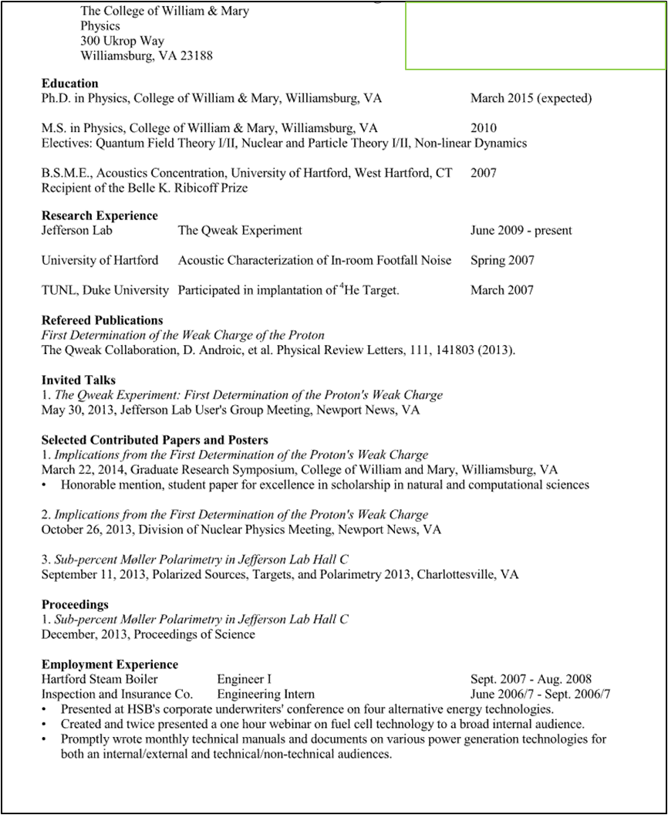
( ) -
---

Slide 15
